Slide 1

SDG Number- 09 Industry, Innovation and Infrastructure
Department Of Artificial Intelligence and Data Science
Project Presentation -3
Project Title- Text-Guided Artistic Image Synthesis Using Diffusion Model
Presented By:
1. Shivani M. Patil [69]
2. Sanskruti S. Sitapure [71]
3. Madhavi D. Patil [53]
4. Snehal J. Patil [55]
Guided By: Dr. Mayura Shelke

Slide 2
Abstract
This abstract explores the synergy between Artificial Intelligence (AI) and stable diffusion models in the realm of text-to-art generation. Leveraging advanced algorithms, this innovative approach translates textual prompts into visually compelling artworks. Stable diffusion models play a crucial role by ensuring controlled and coherent information spread on the canvas. Through this harmonious fusion of technology and creativity, artists and designers can bring their textual concepts to life, generating aesthetically pleasing and meaningful visual representations. This study delves into the transformative potential of this technology, examining its applications in various domains, and illuminating the evolving landscape where AI-driven algorithms redefine artistic expression.

Slide 3
Introduction
AI text-to-art generation, employing stable diffusion models, represents a groundbreaking fusion of technology and creativity. This innovative approach translates textual prompts into visually captivating artworks by ensuring a controlled and harmonious diffusion of information across the canvas. By imposing stability constraints, these algorithms maintain coherence and fidelity to the input text, empowering artists and creators to transform their ideas into compelling visual representations. Beyond artistic expression, this technology finds applications in diverse sectors, promising a future where AI seamlessly integrates with human creativity, redefining the boundaries of artistic innovation.

Slide 4
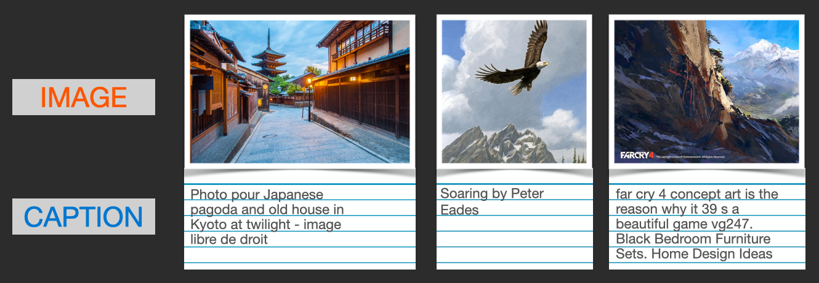
Problem Statement
To develop a fresh and imaginative approach that can generate superb artistic visuals from written descriptions supplied by users.
To create an image encoder that converts unprocessed images into a series of numbers with a corresponding decoder, a model that converts a written prompt into an encoded image, and a model that assesses the quality of the images created for improved filtering.

Slide 5
Literature Survey Summary
Ref. no. | Research Paper Title | Year of Publication & Authors | Methodology Adapted | Major Findings
[1] | Hierarchical Text-Conditional Image Generation with CLIP Latents | Aditya Ramesh et al., (2022) | The author designed a full text-conditional image generation stack named unCLIP, since it generates images by inverting the CLIP image encoder and training diffusion priors in latent space to show that they achieve comparable performance to autoregressive priors while being more compute-efficient. | A two-stage model: generates a CLIP image embedding given a text caption, and a decoder that generates an image conditioned on the image embedding.
[2] | VQGAN-CLIP: Open Domain Image Generation and Editing with Natural Language Guidance | Katherine Crowson et al., (2022) | The author demonstrates a novel methodology for both tasks which is capable of producing images of high visual quality from text prompts of significant semantic complexity without any training by using a multimodal encoder to guide image generations using CLIP to guide VQGAN to produce higher visual quality outputs. | Presented VQGAN-CLIP to produce higher-quality visual images — for the textual prompt and image content have low semantic similarity
[3] | High-Resolution Image Synthesis with Latent Diffusion Models | Robin Rombach et al., (2022) | By incorporating cross-attention layers into the model architecture, the author transforms diffusion models into strong and adaptable generators for generic conditioning inputs like text or bounding boxes, and convolutional high-resolution synthesis is made possible. | In comparison to pixel-based Diffusion Models, latent diffusion models (LDMs) significantly reduce computational requirements while achieving a new state of the art for image inpainting and highly competitive performance on a variety of tasks, such as super-resolution, semantic scene synthesis, and unconditional image generation.
[4] | Gorgeous Pixel Artwork Generation with VQGAN-CLIP | Tan Yuan et al., (2022) | The author has used VQGAN-CLIP, Perception Engines, CLIPDraw, and sampling generative networks to create novel pixel art from a user-submitted text prompt. | The study is about the utilization of VQGAN-CLIP, NLP, and Gradient to generate novel clip artwork using a single prompt.
[5] | Photorealistic Text-to-Image Diffusion Models with Deep Language Understanding | Chitwan Saharia et al.,(2022) | Researchers discovered that expanding the size of these language models had a substantially greater influence on overall performance than scaling the size of the U-Net reiterating the value of classifier-free and introducing dynamic thresholding,which enables the use of even greater guidance weights. | Researchers discovered that expanding the size of these language models had a substantially greater influence on overall performance than scaling the size of the U-Net reiterating the value of classifier-free and introducing dynamic thresholding,which enables the use of even greater guidance weights.

Slide 6
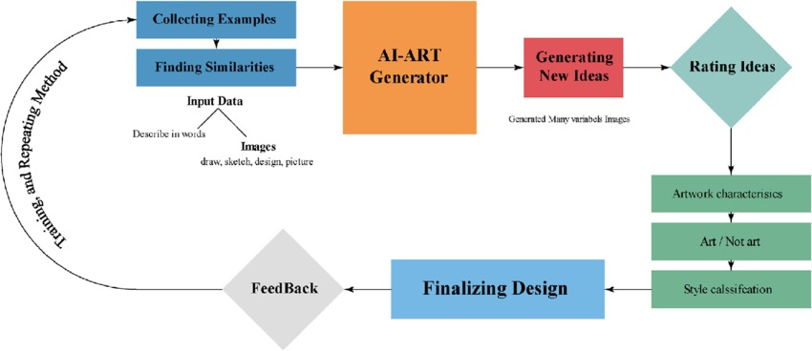
Proposed System
An AI text-to-art generation system combines natural language processing and computer vision resulting in Generative models to transform textual descriptions into visual artworks. It begins with data collection and preprocessing of text and images, utilizing NLP and computer vision models. A mapping mechanism connects text to visual features, enabling the generation of art pieces. Optional style transfer and post-processing enhance the results. User feedback refines the output, and ethical considerations are integrated. Deployment through user-friendly interfaces ensures accessibility, while ongoing maintenance and updates drive system improvement. Documentation and support aid users in utilizing this innovative AI-powered creative tool.

Slide 7
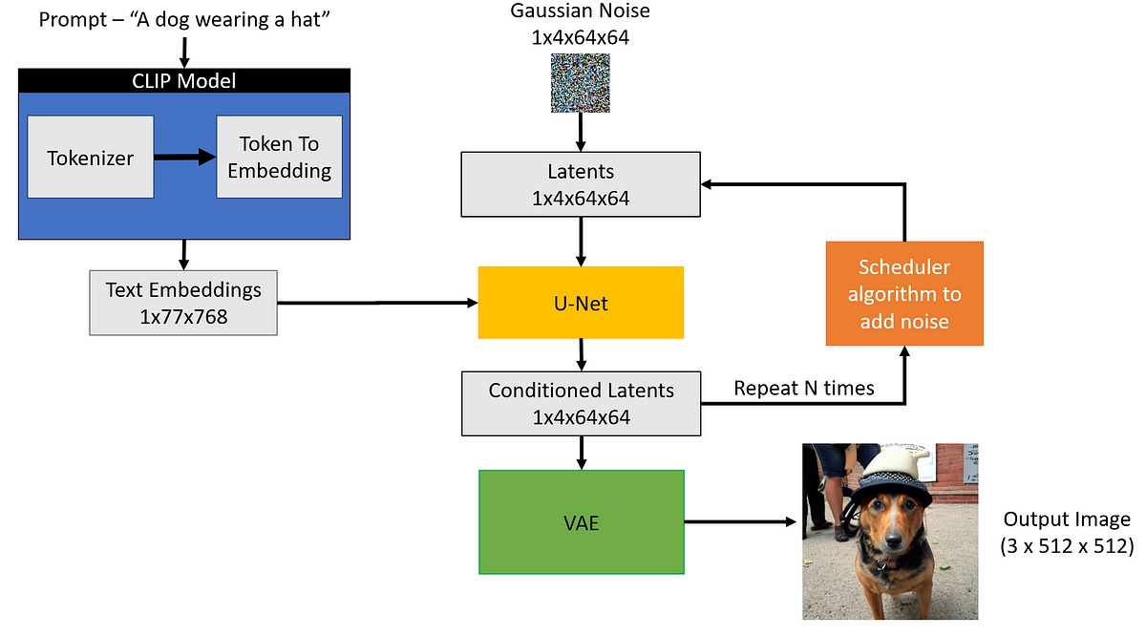
Architecture

Slide 8
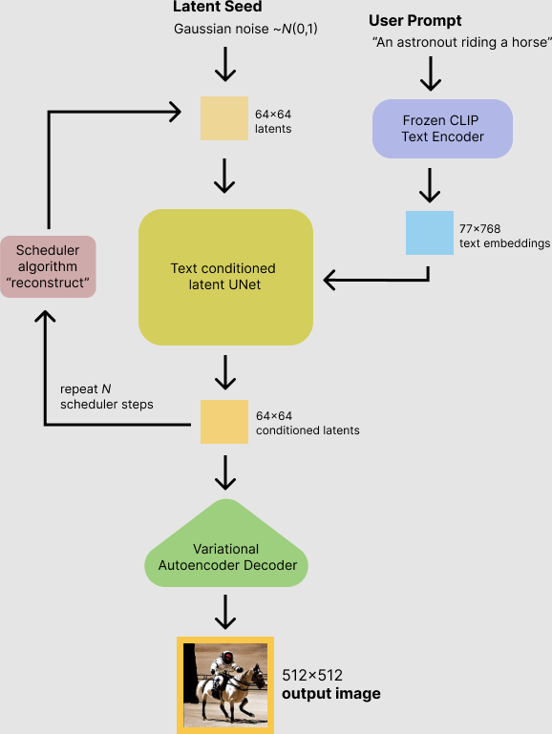
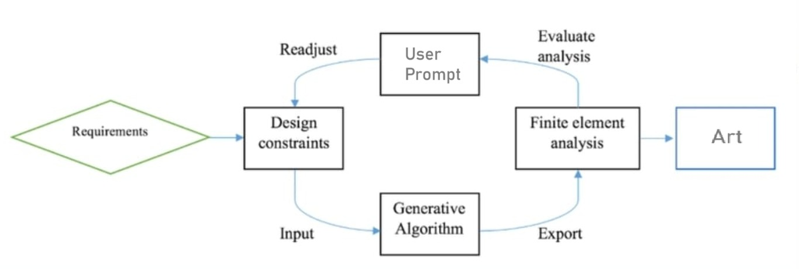
Software and Design Required/ Algorithm Required

Slide 9
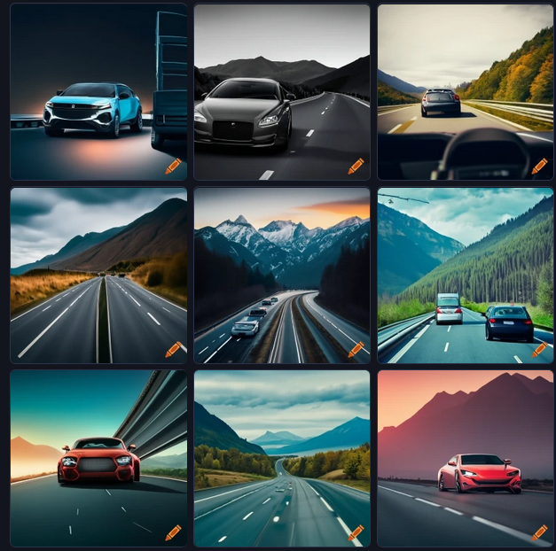
Algorithm Required
Stable Diffusion –
Stable Diffusion is a deep learning, text-to-image model released in 2022 based on diffusion techniques.
AI model for generating detailed images from text.
Uses diffusion for high-quality image generation.
Operates in a lower-dimensional latent space.
Stable Diffusion based on the text prompt
Prompt: A Realistic Car on a Freeway With Mountains in the Background

Slide 10
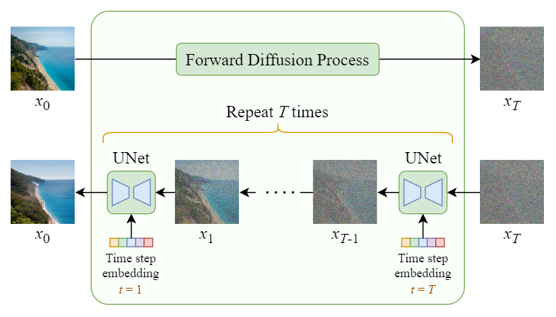
Mathematical Equation

Slide 11
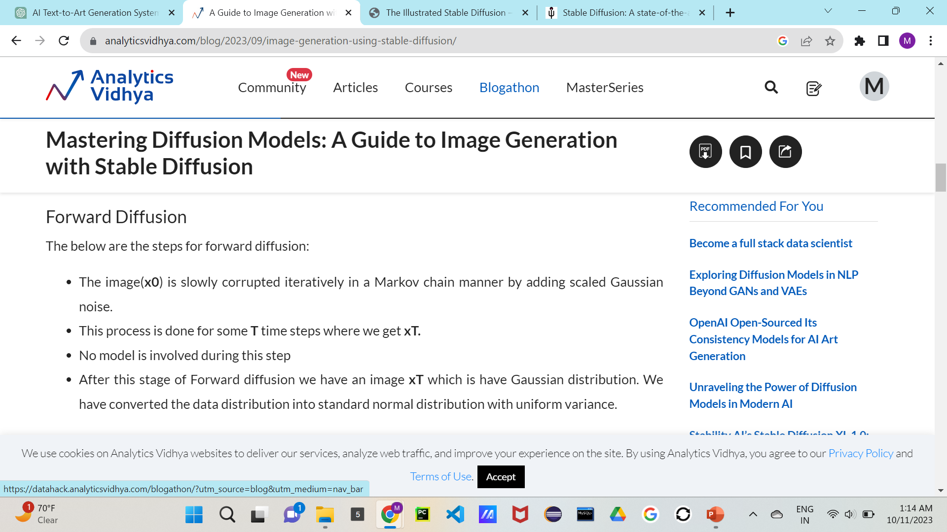
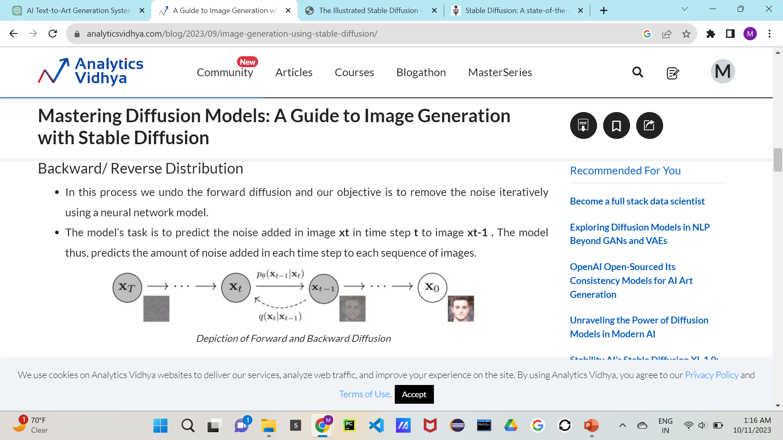

Slide 12
Implementation: Design
Attention: In the context of machine learning, attention mechanisms allow models to focus on specific parts of the input when making predictions, enabling better handling of sequential data.
CLIP (Contrastive Language-Image Pretraining): A neural network model designed for learning visual concepts from natural language descriptions.
Encoder: A component in a neural network that transforms input data into a compressed or encoded representation.
DDPM (Denoising Diffusion Probabilistic Model): A probabilistic generative model used for tasks such as image synthesis, which models the diffusion process of an image.
Decoder: In the context of neural networks, a decoder is a component that transforms encoded or compressed representations back into the original data format.
Diffusion: Refers to spreading information or data through a medium, often used in the context of diffusion models in machine learning.
Model Converter: A tool or module that converts models from one framework or format to another, facilitating interoperability.
Model Loader: A component responsible for loading trained models or saved model weights into a program.
Tokenizer Merges: In natural language processing, tokenization involves breaking down text into smaller units called tokens. Tokenizer merges refer to combining or grouping certain tokens during the tokenization process.
Tokenizer Vocab: The tokenizer’s vocabulary consists of all the unique tokens that the tokenizer can recognize.

Slide 13
Implementation: Platform
Software Requirement
Compiler/Editor: Python IDE ,Google
Collaboratory
GUI: Frameworks like Gradio or HTML/CSS/JavaScript
Library: PyTorch, NumPy, Pandas, and matplotlib
Platform: Windows
Language: Python
Hardware Requirement
Processor: A multi-core processor (e.g., Intel Core i5 or equivalent)
RAM: Minimum 8GB RAM to handle data processing and deep learning tasks.
Graphics Card: A dedicated graphics card with at least 2GB of memory

Slide 14
Implementation: Coding

Slide 15
Implementation: Optimization

Slide 16
Testing of all modules

Slide 17
Research Paper Publication
Review Paper: ADVANCEMENTS IN TEXT-GUIDED ARTISTIC IMAGE SYNTHESIS: A COMPREHENSIVE REVIEW OF DIFFUSION MODEL APPROACHES AND FUTURE DIRECTIONS
Journal: International Journal Of Creative Research Thought(IJCRT)
Volume 11, Issue 12, ISSN: 2320-2882
Date: December 2023
Link: https://r.search.yahoo.com/_ylt=Awr1QTypybdlG4IbCgy7HAx.;_ylu=Y29sbwNzZzMEcG9zAzEEdnRpZAMEc2VjA3Ny/RV=2/RE=1706572329/RO=10/RU=https%3a%2f%2fijcrt.org%2fpapers%2fIJCRT2312617.pdf/RK=2/RS=ayOD.o4h6ZXD7KxrVO8Ub1Gbuis-

Slide 18
Copywrite Information

Slide 19
Conclusions
In conclusion, the design phase of the AI text-to-art generation project using Stable Diffusion, PyTorch, and Python lays a strong foundation for the successful development of a creative and innovative system. This phase is critical for planning, structuring, and defining the key components of the project. In our AI text-to-art generation project's literature review and design phase, we conducted a comprehensive survey of existing research and methodologies in generative art synthesis. This phase was crucial for establishing the foundation upon which our project is built, and it guided our design decisions and implementation strategies.

Slide 20
References
[1] Ramesh, Aditya, Prafulla Dhariwal, Alex Nichol, Casey Chu, and Mark Chen. "Hierarchical text-conditional image generation with clip latents." arXiv preprint arXiv:2204.06125 1, no. 2 (2022): 3.
[2] Crowson, Katherine, Stella Biderman, Daniel Kornis, Dashiell Stander, Eric Hallahan, Louis Castricato, and Edward Raff. "Vqgan-clip: Open domain image generation and editing with natural language guidance." In European Conference on Computer Vision, pp. 88-105. Cham: Springer Nature Switzerland, 2022.
[3], Robin, Andreas Blattmann, Dominik Lorenz, Patrick Esser, and Björn Ommer. "High-resolution image synthesis with latent diffusion models." In Proceedings of the IEEE/CVF conference on computer vision and pattern recognition, pp. 10684-10695. 2022.
[4] Yuan, Tan, Xiaofeng Chen, and Sheng Wang. "Gorgeous Pixel Artwork Generation with VQGAN-CLIP.“, 2022.
[5] Saharia, Chitwan, William Chan, Saurabh Saxena, Lala Li, Jay Whang, Emily L. Denton, Kamyar Ghasemipour et al. "Photorealistic text-to-image diffusion models with deep language understanding." Advances in Neural Information Processing Systems 35 (2022): 36479-36494.

Slide 21
17 Sustainable Development Goals (SDGs)
GOAL 1: No Poverty
GOAL 2: Zero Hunger
GOAL 3: Good Health and Well-being
GOAL 4: Quality Education
GOAL 5: Gender Equality
GOAL 6: Clean Water and Sanitation
GOAL 7: Affordable and Clean Energy
GOAL 8: Decent Work and Economic Growth
GOAL 9: Industry, Innovation and Infrastructure
GOAL 10: Reduced Inequality
GOAL 11: Sustainable Cities and Communities
GOAL 12: Responsible Consumption and Production
GOAL 13: Climate Action
GOAL 14: Life Below Water
GOAL 15: Life on Land
GOAL 16: Peace and Justice Strong Institutions
GOAL 17: Partnerships to achieve the Goal

Slide 22
Map the project title with PO's and PSO's on the scale of 3. 3-Substantial mapping 2-Moderate mapping 1-Low mapping
Gr. No | Project Title | Project Guide | PO1 | PO2 | PO3 | PO4 | PO5 | PO6 | PO7 | PO8 | PO9 | PO10 | PO11 | PO12 | PSO1 | PSO2 | PSO3
A6 | Text-Guided Artistic Image Synthesis Using Diffusion Model | Dr. Mayura Shelke | 3 | 3 | 2 | 2 | 3 | 2 | - | 3 | 3 | 2 | 2 | 3 | 2 | 3 | 2

